Slide 1
Topic: 6
Interviews
ESOL FOR JOB SEEKERS
Prepare for job interviews by practising questions and answers in English

Slide 2
Session Objectives
By the end of this session, learners will be able to:
Understand common job interview questions
Practise answering interview questions
Use polite language and body language
Take part in pair and group interview role-plays

Slide 3

Warm-Up Game – Interview Chain
Instructions:
Sit in a circle.
The first person asks a simple question (e.g., “What is your name?”).
The next person answers and asks a new interview question.
Continue the chain!
🗣 Aim: Practise fluency and confidence with speaking.

Slide 4
Common Interview Questions
Can you tell me about yourself?
What experience do you have?
Why do you want this job?
What are your strengths?
Do you have any questions?

Slide 5
Good Answers – Useful Phrases
“I have experience working as a…”
“I am hardworking and always on time.”
“I want to learn new skills.”
“I work well in a team.”
“Can you tell me about the hours?”

Slide 6
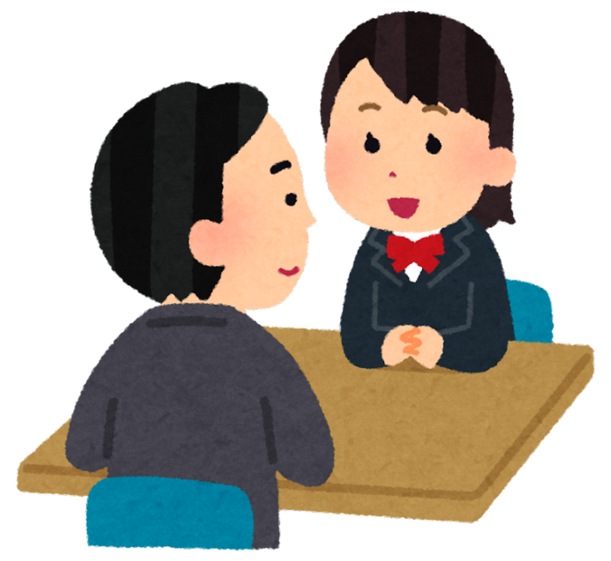
Pair Discussion
Mini Interviews. Work in pairs:
One person is the interviewer.
One person is the job applicant.
Use the sample questions and answer cards.
🕒 Switch roles after 5–10 minutes.
✅ Encourage polite expressions and eye contact.

Slide 7
Dos in Interviews
Dress neatly and appropriately (clean clothes, smart appearance).
Arrive on time – 5 to 10 minutes early is best.
Greet the interviewer politely – say “Good morning” or “Nice to meet you.”
Make eye contact and smile.
Listen carefully to the questions before answering.
Speak clearly and politely.
Answer confidently using full sentences.
Give real examples of your experience or skills.
Ask a simple question at the end – e.g., “What are the hours?”
Say thank you at the end of the interview.

Slide 8
❌ Don’ts in Interviews
Don’t arrive late.
Don’t wear very casual clothes like pyjamas, flip-flops, or hats.
Don’t chew gum or eat during the interview.
Don’t look at your phone or use it during the interview.
Don’t give one-word answers like “Yes” or “No.”
Don’t interrupt the interviewer.
Don’t speak too fast or too quietly.
Don’t lie about your experience or skills.
Don’t say “I don’t know” to every question.
Don’t forget to thank the interviewer.

Slide 9
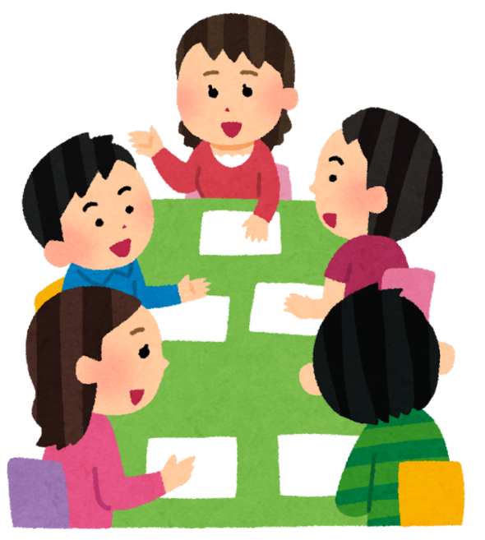
Group Discussion
Group Work – Interview Panel Role-Play
1 student is the interviewee.
2–3 students are the interview panel.
Use job role cards (e.g., cleaner, shop assistant, kitchen porter).
Act out the interview, then give feedback.
What was good? What can be improved?

Slide 10
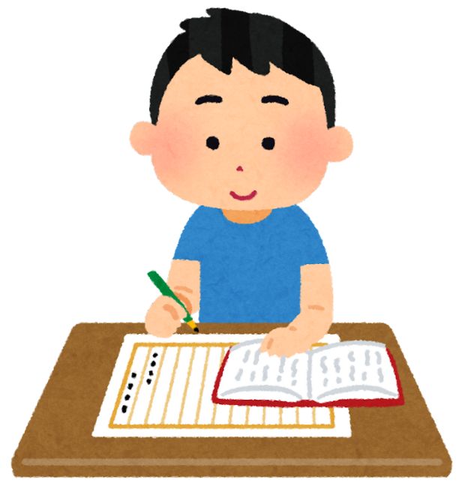
Homework
📝 Interview Practice Worksheet
Match questions and answers
Write short answers to 3 questions
Practise at home with a family member or friend
📅 Bring it back next session for pair practice!

