Slide 1
Topic: 10 Workplace Problems and Solutions
ESOL FOR JOB SEEKERS
Learn how to talk about common workplace problems and how to solve them using simple English.

Slide 2
Session Objectives
By the end of the session, learners will: ✅ Identify common workplace problems ✅ Use simple English to describe problems ✅ Suggest polite solutions ✅ Practise speaking in pairs and groups

Slide 3

Warm-Up Game – “What’s the Problem?”
Instructions Show pictures of workplace problems (e.g., late to work, broken machine, rude customer).
Ask: 👉 “What is the problem?” 👉 “What can the person do?”
Example: 👩‍🍳 Picture of a broken microwave 💬 "The microwave is broken. She can tell the manager."
(Use images on the next slides)

Slide 4

Warm-Up Game – “What’s the Problem?”

Slide 5

Warm-Up Game – “What’s the Problem?”

Slide 6

Warm-Up Game – “What’s the Problem?”

Slide 7

Warm-Up Game – “What’s the Problem?”

Slide 8

Warm-Up Game – “What’s the Problem?”

Slide 9

Warm-Up Game – “What’s the Problem?”

Slide 10
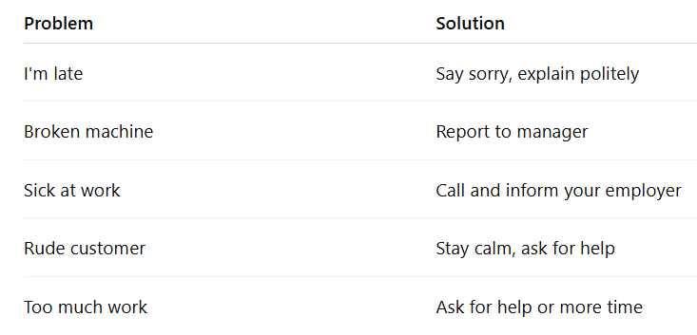
Key Vocabulary

Slide 11

Pair Discussion
Talk to your partner: What problems do people have at work? What can you say if… – You are late? – You don’t understand something? – A customer is rude?
(Encourage polite phrases: “Sorry I’m late”, “Can you help me, please?”)

Slide 12

Group Discussion
Group task: Each group gets a problem card (SEE ON THE NEXT SLIDES). 🧠 Discuss: – What’s the problem? – What are 2 possible solutions? 🗣️ Present your ideas to the class!

Slide 13

GROUP DISCUSSION PROBLEM CARD: 1

Slide 14

GROUP DISCUSSION PROBLEM CARD: 2

Slide 15

GROUP DISCUSSION PROBLEM CARD: 3

Slide 16

GROUP DISCUSSION PROBLEM CARD: 4

Slide 17
Language Focus – Polite Phrases
🔹 “Excuse me, can I talk to you?” 🔹 “I’m sorry, I was late because…” 🔹 “Can you please explain it again?” 🔹 “There is a problem with…” 🔹 “Can I help you with something?”
Let learners repeat and practise in pairs

Slide 18

Homework
Homework
📝 Write about a workplace problem you had (real or imagined): – What happened? – What did you say? – What happened next?
Optional: Ask family/friends about a problem they had at work.

