Slide 1
Topic: 3 Daily Routine at Work
ESOL FOR JOB SEEKERS
Talk about your daily tasks, routines, and times at work using everyday English

Slide 2
Session Objectives
By the end of this session, you will:
Learn and use daily work routine vocabulary.
Talk about what you do at work and when.
Use simple present tense for daily tasks.
Ask and answer routine questions.
Write short sentences about your routine.
Understand a short listening about someone’s workday.

Slide 3

Warm-Up Game – “Daily Job Mime”
Game: One learner mimes a job task (e.g., sweeping, typing, cooking). Others guess the job and time. Example: Mime = “typing on computer” “You are an office worker!” “You work at 9 o’clock!”
Skills: Speaking, listening, vocabulary recall.

Slide 4
Key Vocabulary
🧹 Clean 🖨️ Type 🔧 Fix 📞 Answer (phones) 📦 Pack 📝 Write 🕘 Times: at 7 o’clock, in the morning, at noon, in the evening 🗓️ Frequency: every day, always, usually, sometimes, never

Slide 5
Grammar Focus
Simple Present Tense for Routines
I start work at 9.
She cleans the floor.
He finishes at 5.
We have lunch at 12.
Use: s/es with he/she/it

Slide 6
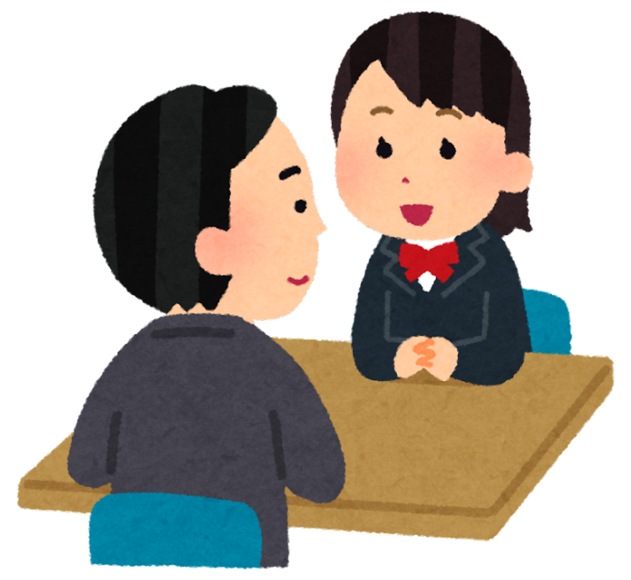
Pair Discussion
Talk to your partner: Ask and answer:
What time do you start work?
What do you do in the morning?
Do you have a break? When?
✏️ Write short notes about your partner’s routine.

Slide 7
Writing Practice
✍️ Write 3–5 sentences about your daily routine at work. Use:
Time phrases (at 9 o’clock, in the morning)
Verbs (clean, start, write, serve)
Frequency words (always, sometimes)

Slide 8
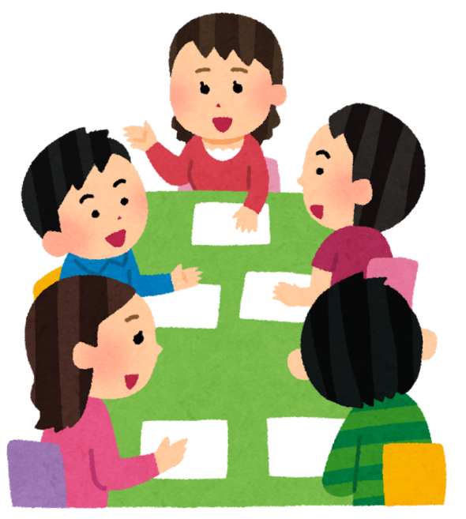
Group Activity
“Timetable Challenge”
In small groups:
Make a daily timetable for a job (e.g., cleaner, kitchen assistant, warehouse worker).
Include times and tasks. 🕘 Use time phrases and verbs. 📊 Present your routine to the class.

Slide 9
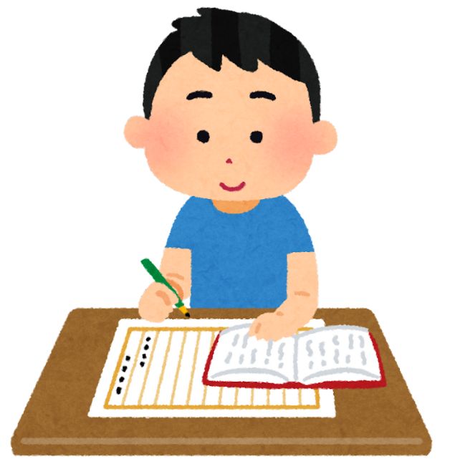
Homework
Write about your daily work routine (5 sentences).
Interview a friend/family member about their work routine and write 3 sentences.

