Slide 1
Topic: 6 Online Safety, Bullying & Child Well-being
Keeping Up With The Children
Helping Your Child Stay Safe and Happy Online

Slide 2
Session Objectives
Understand online risks and safety
Recognise signs of bullying (online and offline)
Explore ways to support children’s mental health

Slide 3

Warm-Up Game 1– “What’s Online?”
Task: In pairs, name 5 apps/websites your child uses.
Share with the group. Are they safe? Do you use them?
Discussion starter for the next slide.

Slide 4
Warm-Up Game 2 – “Emoji Reactions
Show emojis (😟 😡 😢 😃 😰) and ask:
"How might a child feel if…?“
They are left out of a group chat
Someone calls them names online
They play games with a friend
A stranger messages them

Slide 5
What is Online Safety?
Keeping personal info private
Not talking to strangers
Avoiding inappropriate websites
Using strong passwords
Using parental controls

Slide 6
Online Risks for Children
Inappropriate content (violence, adult content)
Cyberbullying
Sharing personal information
Talking to strangers
Spending too much time online

Slide 7
What is Bullying?
Bullying is repeated unkind behaviour
Can be physical, verbal, or emotional
Cyberbullying = bullying using phones, games, or social media

Slide 8
Signs of Bullying
Quiet, withdrawn behaviour
Sudden fear of going to school
Changes in mood or eating
Hiding phone or tablet Pair discussion: "Have you seen these signs before?"

Slide 9
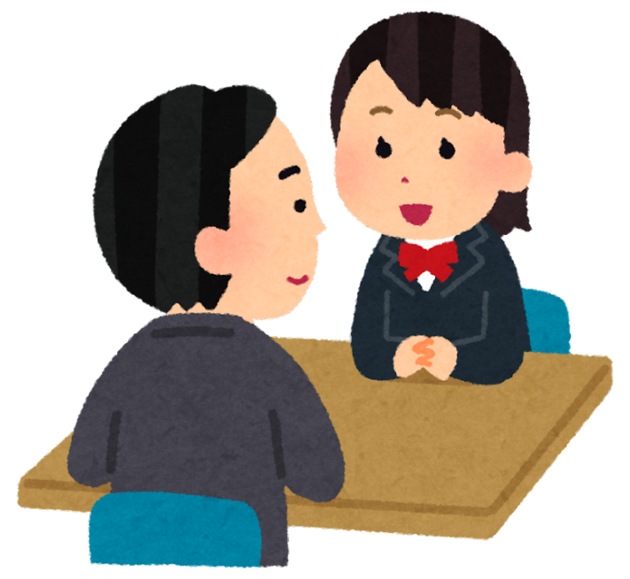
Pair Discussion Spot the Risk
Show 3 short situations (spoken or written):
1. “Ali shares his full name and school on a gaming app.”
Task: Discuss in pairs – is it safe or not? Why?

Slide 10
Pair Discussion Spot the Risk
Scenario 2: Sara accepts a friend request on social media from someone she doesn’t know, but who has many followers.
Discussion prompts:
Is it safe? What could go wrong? What should Sara do instead?

Slide 11
Pair Discussion Spot the Risk
Scenario 3:Zain watches videos late at night in his room with the door closed. He gets angry when his mum asks him what he is watching." Discussion prompts:
What might be the issue? Is this safe and healthy? How can parents support Zain?

Slide 12
What Can Parents Do?
Talk to your child regularly
Set rules for internet use
Use filters and child-safe apps
Report bullying to the school
Encourage healthy habits: sleep, play, and no screen before bed

Slide 13
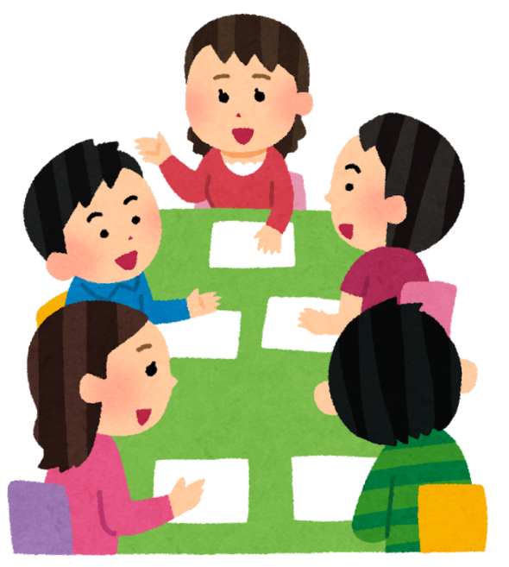
Group Discussion
Question: How can we support our children if they are being bullied online or offline?
Write ideas on the board

Slide 14
Emotional Well-being in a Digital World
Too much screen time affects sleep, mood, learning
Children may copy negative behaviour they see online
Need time for play, exercise, family time, reading

Slide 15
Signs Your Child May Be Unhappy Online
Angry or upset after using devices
Hiding the screen or not wanting to talk
Less interest in normal activities
Trouble sleeping or concentrating

Slide 16
Support & Resources
Useful websites: Thinkuknow, NSPCC, Internet Matters
At school: Speak to your teacher or safeguarding lead
At home: Open communication is key

Slide 17
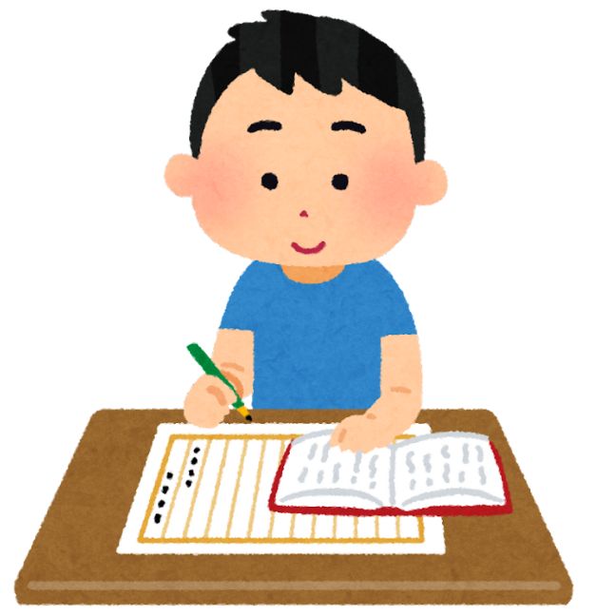
Homework
Talk to your child about online rules
Create a simple screen time timetable
Watch a short online safety video together
Write or discuss: "What would you do if your child told you they were being bullied?"

