Slide 1
TOPIC: 7
Workplace Communication
ESOL FOR JOB SEEKERS
Learn to speak, listen, read, and write effectively at work

Slide 2
Session Objectives
By the end of this session, you will be able to:
Use common workplace communication phrases
Understand formal vs informal language
Practise speaking and listening in a work context
Complete basic workplace forms

Slide 3

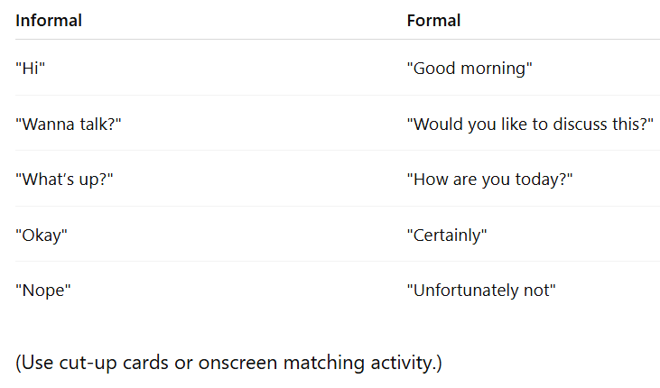
Warm-Up Game –
“Match the Phrase”
🧩 Match informal phrases with formal phrases used at work.

Slide 4
Key Vocabulary and Phrases
Common Phrases at Work:
“Can you help me with this?”
“I’m not sure. Let me check.”
“Please send me an email.”
“Let’s have a meeting.”
“Can we speak after lunch?”

Slide 5

Pair Discussion
Talk to your partner:
How do you speak to your manager?
What do you say if you are late?
What do you say when you need help?
Encourage use of polite/formal phrases.

Slide 6
SAMPLE ANSWERS (PAIR DISCUSSION)
Q1: How do you speak to your manager?
Sample Answers:
"Good morning, I hope you're well."
"Can I speak with you for a moment, please?"
"Would it be okay if I ask you a question?"
"Excuse me, I need some help with this task."

Slide 7
SAMPLE ANSWERS (PAIR DISCUSSION)
Q2: What do you say if you are late?
Sample Answers:
"I’m sorry I’m late. There was a problem with the bus.“
"Apologies for the delay. I had a personal emergency.“
"I’ll make sure to leave earlier next time."

Slide 8
SAMPLE ANSWERS (PAIR DISCUSSION)
Q3: What do you say when you need help?
Sample Answers:
"Excuse me, could you please help me with this?"
"I’m not sure how to do this. Can you show me, please?"
"Would you mind explaining this task again?"

Slide 9
Reading and Writing
Workplace Form Practice:
Read a short email
Fill in a simple communication log or message note
Example: “Call from customer about order – please reply today.”

Slide 10
Sample Email (for reading & writing task):
Subject: Customer Call – Order Enquiry
Dear Team,
A customer named Mr. Ahmed called today at 10:15 a.m. regarding his order #3485. He said the items haven’t arrived yet and asked for an update.
Please contact Mr. Ahmed before the end of the day to let him know the delivery status. His phone number is 07983 123 456.
Kind regards,
Alex Green
Customer Service Supervisor

Slide 11
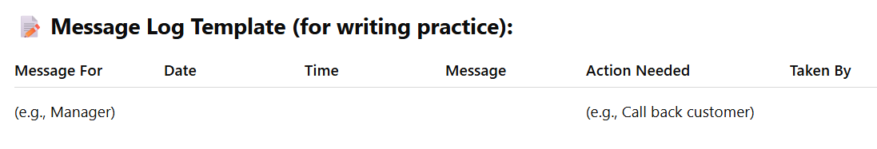
Sample Email (for reading & writing task):

Slide 12
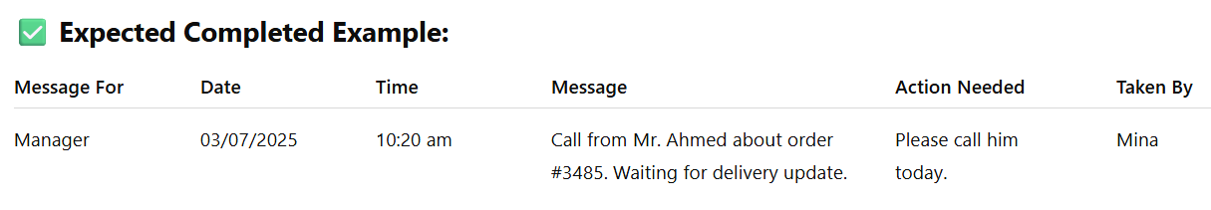
Sample Email (for reading & writing task):

Slide 13

Group Discussion
Scenario-Based Practice:
You work in a supermarket. Talk about:
Asking for a break
Helping a customer find an item
Telling your team about a delivery delay
👉 Practise using polite, clear language

Slide 14
SAMPLE ANSWERS (GROUP DISCUSSION)
Scenario 1: Asking for a break
Sample Answers:
"Excuse me, may I take my break now?"
"Is it okay if I go on my 15-minute break?"
"I’ve finished my task—can I take my break, please?"

Slide 15
SAMPLE ANSWERS (GROUP DISCUSSION)
Scenario 2: Helping a customer find an item
Sample Answers:
"Can I help you find something?"
"The bread is in aisle 3, next to the milk."
"Let me show you where it is."
"I’ll check in the back for you. One moment, please."

Slide 16
SAMPLE ANSWERS (GROUP DISCUSSION)
Scenario 3: Telling your team about a delivery delay
Sample Answers:
"Just to let you know, the delivery is running late today."
"We’ve had a delay with the stock delivery—it should arrive in the afternoon."
"Please inform the manager that the delivery is not here yet."

Slide 17

Homework
Speaking Practice at Home:
Practise saying 3 polite work phrases
Write a short message to your boss (real or imagined)
Example: “Dear Manager, I will be late today because of transport. Thank you.”

