Slide 1
Topic:8
Customer Service & Dealing with People
ESOL FOR JOB SEEKERS
Learn how to speak politely and clearly with customers, colleagues, and the public at work

Slide 2
Session Objectives
By the end of this session, you will be able to:
✔ Understand what good customer service means
✔ Learn useful customer service phrases
✔ Practise polite and helpful communication
✔ Respond to different situations with confidence

Slide 3

Warm-Up Game –
“Good or Bad Service?”
“Good or Bad Service?”
🟢 Show short role-play text of customer service (good/bad).
👥 Learners say: “Good service” or “Bad service” and explain why.
🗣 Prompt phrases: “They are smiling,” “They are rude,” “He is helpful.”

Slide 4
Warm-Up Game –
“Good or Bad Service?”
Role-Play Clip 1:
Customer: Hello, can you help me, please?
Staff (smiling): Of course! What do you need help with?
Customer: I’m looking for bread.
Staff: Aisle 3, on the left. Let me show you.
Good or Bad Service?

Slide 5
Warm-Up Game –
“Good or Bad Service?”
Role-Play Clip 2:
Customer: Excuse me, is this till open?
Staff (shrugging, looking bored): Yeah, whatever. Put your stuff here.
Customer: Can I pay by card?
Staff: If you want.
Good or Bad Service?

Slide 6
Warm-Up Game –
“Good or Bad Service?”
Role-Play Clip 3:
Customer: Hi, I have a question about my delivery.
Staff: I’m happy to help. Can I take your order number?
Customer: Yes, it’s 112345.
Staff: Thank you. One moment please… Your order will arrive tomorrow.
Good or Bad Service?

Slide 7
Warm-Up Game –
“Good or Bad Service?”
Role-Play Clip 4:
Customer: Hello? Excuse me?
Staff: (on phone, chatting with friend, ignores customer)
Customer: I just need help.
Staff: (sighs) Can’t you wait?
Good or Bad Service?

Slide 8
Warm-Up Game –
“Good or Bad Service?”
Role-Play Clip 5:
Customer: This product is broken.
Staff: Oh no! I’m really sorry. Let me replace it for you.
Customer: Thank you.
Staff: I’ll do it quickly. Thank you for telling us.
Good or Bad Service?

Slide 9
Key Vocabulary and Phrases
Customer
Polite
Rude
Please
Thank you
Can I help you?
I’m sorry
Just a moment
I’ll find someone to help you

Slide 10
Customer Service Phrases – Practice
Learners repeat and practise in pairs:
“Hello, how can I help you?”
“I’ll check for you.”
“Sorry for the wait.”
“Thank you for your patience.”
“Have a nice day!”

Slide 11
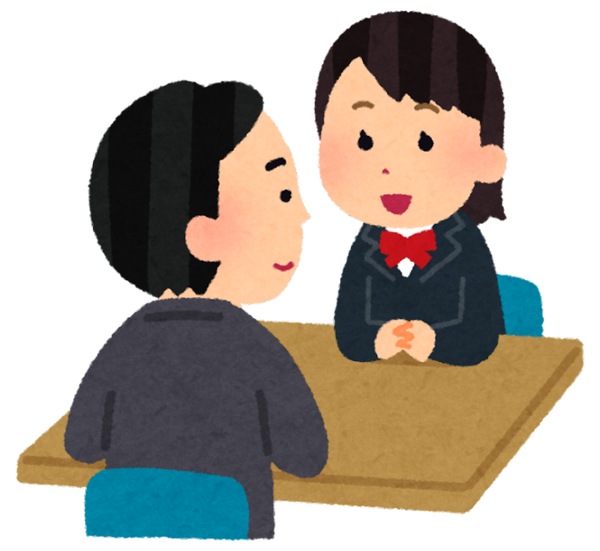
Pair Discussion
Customer Scenarios
🧑‍🤝‍🧑 Role-play with your partner
One is the customer, one is the worker. Take turns.
Situation examples:
A customer wants help finding something.
A customer is angry about a broken item.
A customer asks about a return.
✅ Encourage polite language like:
“Can I help you?” / “I’m sorry about that.” / “One moment, please.”

Slide 12
SAMPLE SITUATION EXAMPLES
🛒 Situation 1: A customer wants help finding something
Customer:
Excuse me, can you help me? I’m looking for rice. Where is it?
Shop Assistant:
Yes, of course. The rice is in aisle 3. I can show you.

Slide 13
SAMPLE SITUATION EXAMPLES
😠 Situation 2: A customer is angry about a broken item
Customer:
I bought this kettle yesterday. It doesn’t work! I’m very upset.
Staff Member:
I’m sorry to hear that. Do you have the receipt? We can replace it or give you a refund.

Slide 14
SAMPLE SITUATION EXAMPLES
🔁 Situation 3: A customer asks about a return
Customer:
Hi, I bought these shoes last week. They don’t fit. Can I return them?
Staff Member:
Yes, no problem. Do you have the receipt? We can offer a refund or exchange.

Slide 15
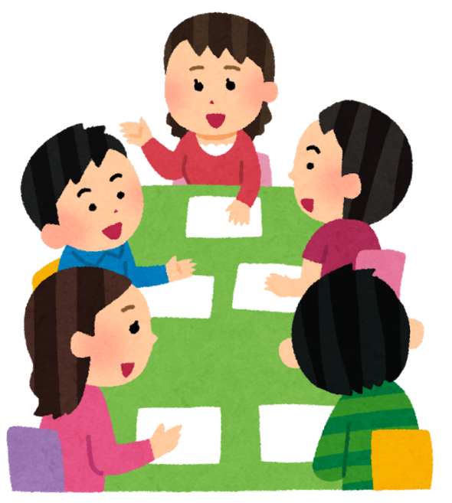
Group Discussion
Group Discussion – What Makes Good Service?
🗣️ Talk together:
What do you like when you go shopping or to a restaurant?
Have you ever had bad service? What happened?
How do you show respect to customers?

Slide 16
Customer Service Quick Quiz
1. What do you say when a customer needs help?
A. Go find it yourself
B. I can help you
C. I don’t know
2. A customer is angry. What should you do?
A. Shout back
B. Walk away
C. Stay calm and listen

Slide 17
Customer Service Quick Quiz
3. Which phrase is polite?
A. Wait!
B. What do you want?
C. How can I help you?
4. A customer wants to return something. What do you ask?
A. Why?
B. Do you have the receipt?
C. What’s your name?

Slide 18
Customer Service Quick Quiz
5. A customer says thank you. What do you say?
A. Ok
B. Bye
C. You’re welcome
6. What should you do if you don’t know the answer?
A. Say nothing
B. Ask a manager or colleague
C. Guess

Slide 19
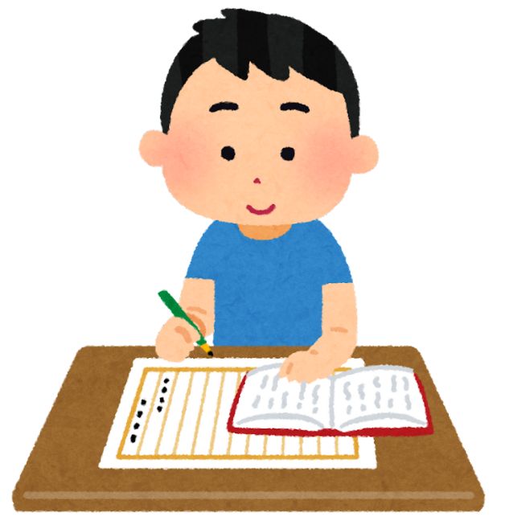
Homework
📝 Write 5 polite customer service
sentences.
Think of one time you helped someone. Write 3 sentences about it.
Optional: Ask someone at home to be your “customer” and practise a short role-play.

