Slide 1
Functional Skills English Entry 3
FACT AND OPINION
&
ARTICLE WRITING

Slide 2
Session Aims
By the end of this session, learners will be able to:
Understand the difference between a fact and an opinion
Identify facts and opinions in short texts
Understand what an accident report is and why we write one
Follow the correct layout for an Entry 3 accident report
Write a clear accident report using mainly facts, a heading, and bullet points

Slide 3
Warm-up: “True or Just My Feeling?”
Look at these sentences. Decide if each one is a Fact or an Opinion.
The college opens at 9 o’clock.
The canteen food is delicious.
Today is Thursday.
English is the most important subject.
Water boils at 100°C.
This classroom is too cold.

Slide 4
PART 1: Facts and Opinions

Slide 5
Simple Definition
A fact is something that is true and can be proved. It does not change because of how someone feels.
An opinion is what someone thinks or feels. It cannot be proved true or false. Different people can have different opinions.

Slide 6
Purpose (Why it matters)
Knowing the difference helps you:
Understand what you read more clearly
Write better reports and reviews
Use mainly facts when you write an accident report

Slide 7
Easy Examples
Fact | Opinion
London is the capital of England. | London is the best city in the world.
The lesson starts at 12:30. | This lesson is boring.
A car usually has four wheels. | Red cars look nicer than blue cars.
The accident happened at 10:30 am. | The floor was dangerously wet.
Clue words for opinions:
I think, I believe, best, worst, beautiful, delicious, should, amazing, terrible

Slide 8
Quick Check
Read this short text. Find one fact and one opinion.
“The library has 20 computers. It is the quietest and nicest place in the college.”

Slide 9
PART 2: Accident Report

Slide 10
Simple Definition
An accident report is a short, clear document that describes what happened when someone was hurt.
It uses facts, not personal feelings.

Slide 11
Purpose (Why it matters)
Accident reports are used at college and work to:
Keep a clear record of what happened
Help stop the same accident happening again

Slide 12
Layout (According to the Pearson Template)
1. Heading: Write Accident Report
2. To: Write who the report is for (for example: The Manager or The Health and Safety Officer)
3. Introduction: (use bullet points)
The day and time of the accident
The name of the person who was hurt
4. Details of the accident: Write a short paragraph explaining clearly what happened. Include how the person was hurt and what help was given.

Slide 13
Exam Rules
You must include a heading
You must use bullet points
Write 4 to 6 sentences
Use mainly facts

Slide 14
Sample Answer
Accident Report
To: The Health and Safety Officer
Introduction:
The accident happened on Wednesday 4th February at 10:30 am.
The person who was hurt was David Miller.
Details of the accident: David Miller was walking in the college corridor and looking at his phone. He tripped over a box of paper and fell. He grazed his knee and hurt his wrist. First aid was given and he rested in the medical room.

Slide 15
Quick Practice
Look at this situation and plan your report:
It is Monday 10th March at 2:15 pm. A student named Amina Khan slips on a wet floor near the toilets. She falls and hurts her ankle. A member of staff helps her and she goes to the medical room.
Write:
The heading
Who it is To
Two bullet points for the Introduction
2–3 sentences for the details

Slide 16
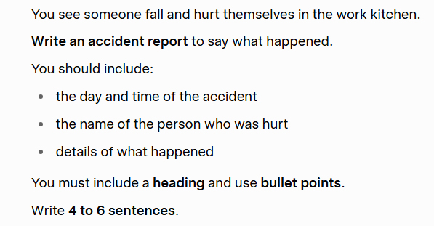
HOMEWORK

