Slide 1
Functional Skills English Entry 3
FORMAL LETTER WRITING

Slide 2
Session Aims
By the end of this session, learners will be able to:
Understand the purpose of a formal letter
Follow the correct layout for an Entry 3 formal letter
Write a clear formal letter that includes all the required information
Use a polite greeting and closing
Write at least 8 sentences, including at least 3 compound sentences
Use at least 2 paragraphs

Slide 3
Warm-Up: “Who Deserves a Thank You?”
Think of someone in your community, college or workplace who helps other people.
Tell your partner:
Who is this person?
What does he or she do to help others?
Why do you think this person is special?
Be ready to share one example with the class.

Slide 4
Simple Definition
A formal letter is a polite letter you write to someone you do not know well, for example the council, a manager, or an organisation. It has a clear structure and uses polite language.

Slide 5
Purpose (Why it matters)
In the Pearson Entry 3 exam you may be asked to write a formal letter to suggest someone for an award or to give your ideas. A good formal letter is clear, polite and well organised.

Slide 6
Layout of a Formal Letter
(According to the Pearson template)
Everything starts on the left-hand side:
Your address
Their address
Date
Greeting → Dear Sir/Madam,
Introductory paragraph (why you are writing)
Main paragraphs (the required information)
Closing → Kind regards,
Your full name

Slide 7
Exam Question
Exam Rules
At least 8 sentences
At least 3 compound sentences
At least 2 paragraphs

Slide 8
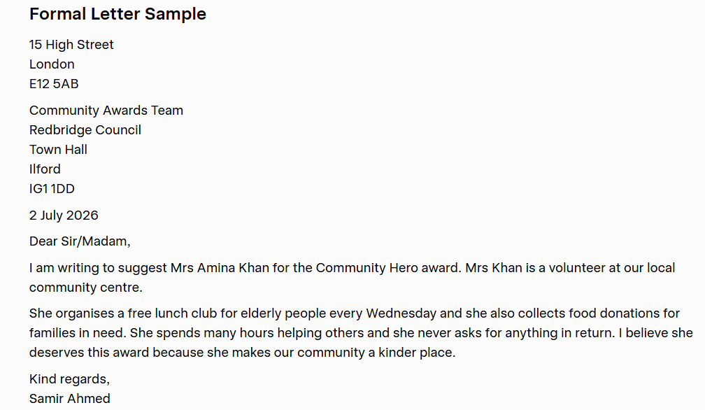

Slide 9
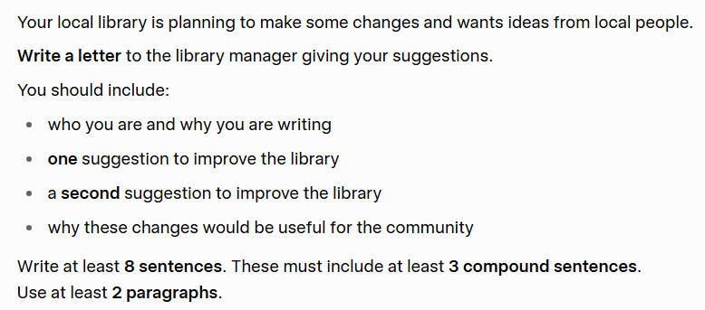
HOMEWORK

