Slide 1
Functional Skills English Entry 3
INFORMAL LETTER WRITING

Slide 2
Session Aims
By the end of this session, learners will be able to:
Understand what an informal letter is
Start the letter correctly with “Dear + name”
Include all the required information from the question
Write at least 8 sentences, including at least 3 compound sentences
Use at least 2 paragraphs
End the letter with a friendly closing and first name

Slide 3
Warm-Up:“Tell Your Friend”
Imagine your friend is moving to your town. Tell your partner one thing:
Something fun to do in your town
Something you like about your town
Something you dislike about your town

Slide 4
Simple Definition
An informal letter is a friendly letter you write to someone you know well, such as a friend or family member. The language is relaxed and personal.

Slide 5
Layout (Exam Style)
In the Pearson exam, you usually start directly with the greeting.
Greeting → Dear Sam,
Opening → Friendly sentence (How are you?)
Paragraph 1 → Answer the first bullet points
Paragraph 2 → Answer the remaining bullet points
Closing → Best wishes, / See you soon, / Take care,
Your first name

Slide 6
Exam Question
Exam Rules
At least 8 sentences
At least 3 compound sentences (and, but, also, because)
At least 2 paragraphs

Slide 7
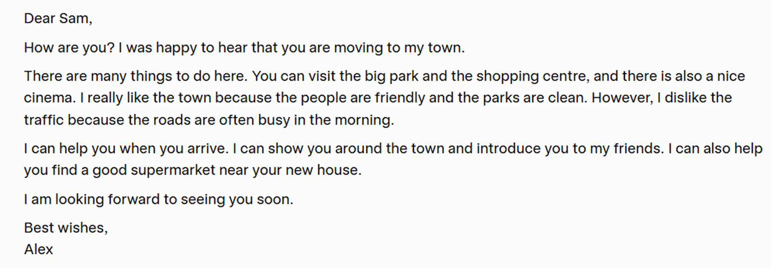
INFORMAL LETTER: SAMPLE ANSWER

Slide 8
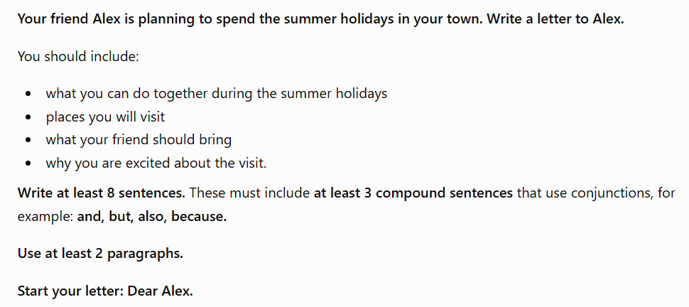
HOMEWORK

