Slide 1
Functional Skills English Entry 3
ONLINE REVIEW WRITING

Slide 2
Session Aims
By the end of this session, learners will be able to:
Understand what an online review is and why people write them
Write a clear and suitable title for a review
Follow the correct layout for an Entry 3 online review
Include what it was about, who was in it, likes and dislikes with reasons
Write at least 8 sentences, including at least 3 compound sentences
Use at least 2 paragraphs

Slide 3
Warm-Up: “Last Thing I Watched or Played”
Think about the last film, TV programme or video game you watched or played.
Tell your partner:
What was it called?
Did you like it? Why or why not?
Would you recommend it to a friend?
Be ready to share one interesting point with the class.

Slide 4
Simple Definition
An online review is a short piece of writing where you give your honest opinion about a film, video game, restaurant, phone or product. It helps other people decide if they want to watch, play or buy it.

Slide 5
Purpose (Why it matters)
In the Pearson Entry 3 exam you may be asked to write a review. A good review is clear, balanced and friendly. It tells the reader both the good points and the bad points.

Slide 6
Layout of an Online Review
(According to the Pearson template)
1. Title
Short and clear (4–8 words)
Include the word “Review”
Tell the reader exactly what you are reviewing
Good examples:
Review of The Lion King
Review of FIFA 25
Samsung Galaxy Phone Review

Slide 7
Layout of an Online Review
(According to the Pearson template)
2. Paragraph 1 – Introduction (The Facts)
What was the film / game called?
What was it about?
Who was in it? (actors or main characters)

Slide 8
Layout of an Online Review
(According to the Pearson template)
3. Paragraph 2 – Your Opinions
What did you like about it and why?
What did you dislike about it and why? (Use However to move from positive to negative)

Slide 9
Layout of an Online Review
(According to the Pearson template)
4. Conclusion
Would you recommend it?
Who would enjoy it?

Slide 10
Exam Rules
At least 8 sentences (aim for 10)
At least 3 compound sentences (use and, but, because, so, or)
At least 2 paragraphs

Slide 11
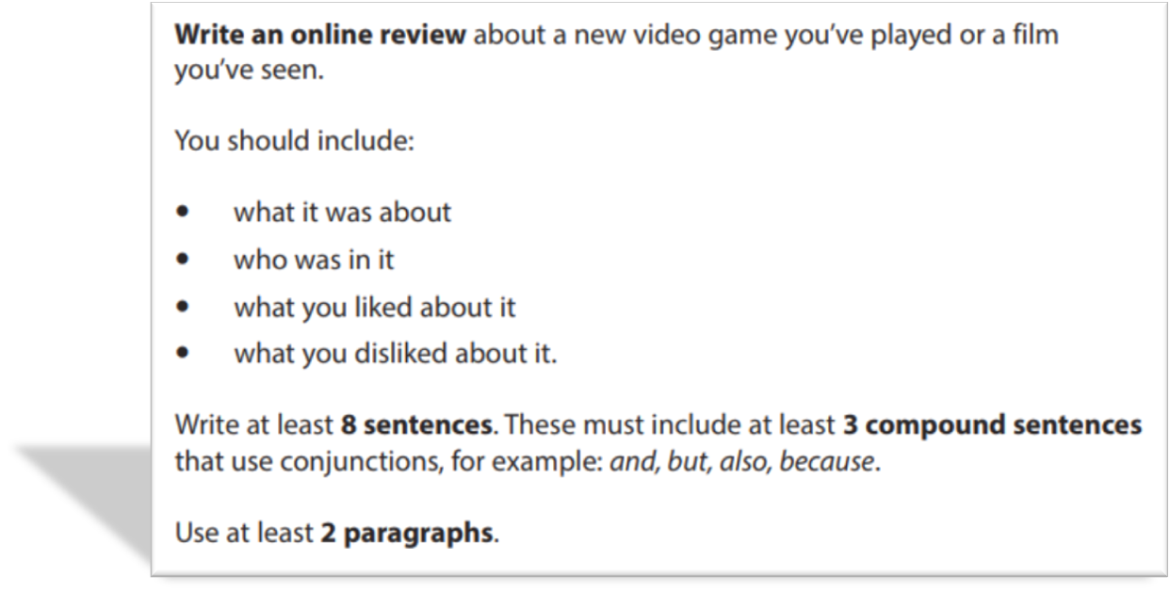
EXAM QUESTION AND SAMPLE ANSWER

Slide 12
Sample Answer: Review of The Lion King
Review of The Lion King
Last weekend I watched the new film called The Lion King. It is about a young lion called Simba who becomes the king of the jungle after his father dies. The main voices in the film are Beyoncé and Donald Glover. The story follows Simba as he grows up and learns to be brave.
I really liked the beautiful animation because the colours were bright and the animals looked real. The songs were also emotional and powerful and I enjoyed listening to them. The story was interesting and exciting from the beginning to the end. However, I didn’t like some parts because they were a bit slow and long. I also found the cinema very busy and I had to wait before the film started.
Overall, I enjoyed the film very much. I would recommend it to everyone, especially families with children, because it is suitable for all ages. I think most people will like this film.

Slide 13
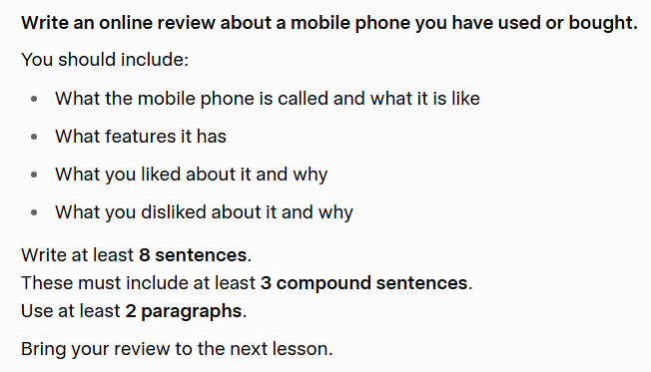
HOMEWORK

