Slide 1
Functional Skills English Entry 3
Text Purpose

Slide 2
Session Aims
By the end of this session, learners will be able to:
Understand what “text purpose” means.
Recognise the main purposes of everyday texts (inform, instruct, persuade, entertain, describe).
Identify the purpose of short, simple texts.
Explain why knowing the purpose helps when reading

Slide 3
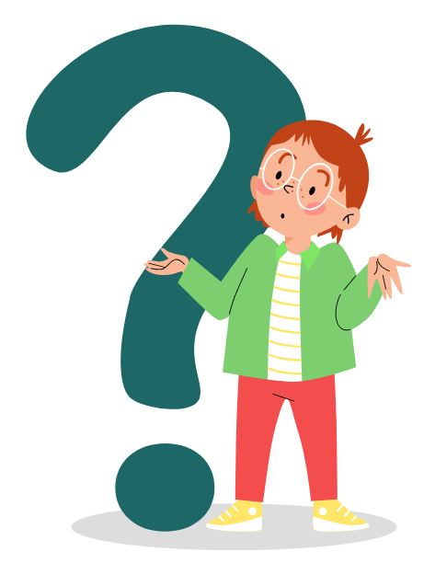
Why do people write things?

Slide 4
What is 'Text Purpose'?
The purpose is the reason why a text is written.

Slide 5
What is 'Text Purpose'?
The purpose is the reason why a text is written.
To inform – give facts or information
Examples: News article, leaflet about opening hours, school newsletter, bus timetable
2. To instruct – tell someone what to do or how to do it
Examples: Recipe, exam instructions, “How to register online” guide, form-filling instructions

Slide 6
What is 'Text Purpose'?
3. To persuade – convince or encourage someone
Examples: Advertisement, charity leaflet, political campaign poster, product promotion
4. To describe – give details about a person, place, or event
Examples: Travel blog, hotel review, story describing a festival, diary entry describing a holiday

Slide 7
What is 'Text Purpose'?
5. To entertain – make the reader enjoy or feel amused
Examples: Short story, magazine cartoon, poem, comic strip
6. To express – share thoughts, feelings, or opinions
Examples: Diary entry, personal email to a friend, social media post, opinion column

Slide 8
What is 'Text Purpose'?
7. To advise – give suggestions or recommendations
Examples: Health leaflet (“Drink more water”), careers advice in a magazine, advice column, “top tips” article
8. To warn – tell someone about danger or risk
Examples: “Caution: Wet Floor” sign, medicine safety label, “Do not enter” notice, workplace health & safety poster

Slide 9
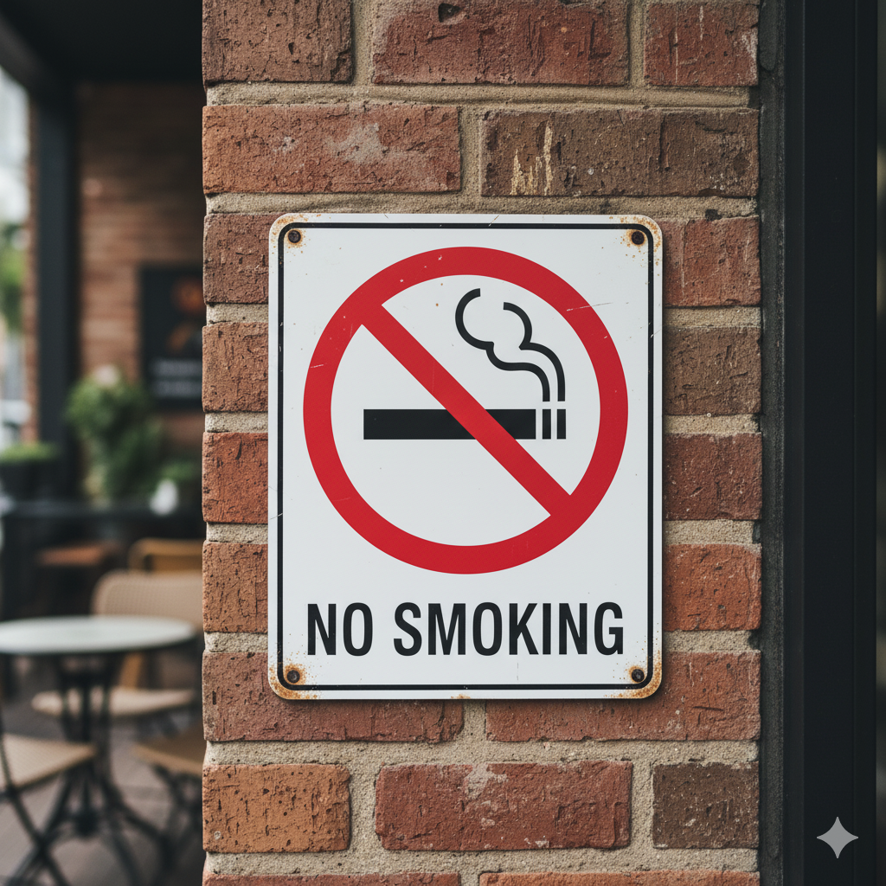
What is 'Text Purpose'?
The purpose is the reason why a text is written.

Slide 10
What is 'Text Purpose'?
ANSWER: To warn/ to inform

Slide 11

What is 'Text Purpose'?
The purpose is the reason why a text is written.

Slide 12
What is 'Text Purpose'?
ANSWER: To express

Slide 13

What is 'Text Purpose'?
The purpose is the reason why a text is written.

Slide 14
What is 'Text Purpose'?
ANSWER: To persuade

Slide 15
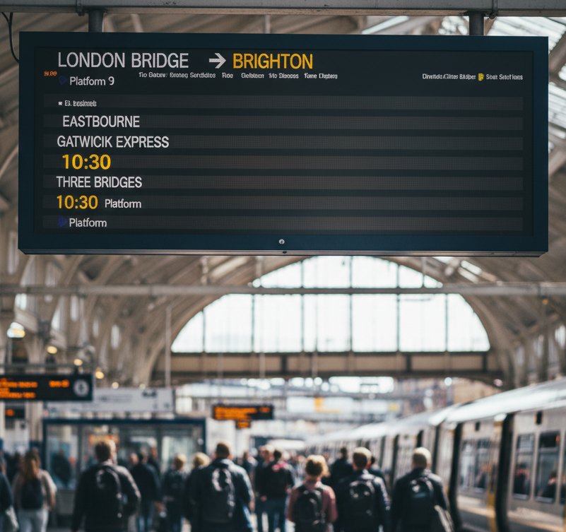
What is 'Text Purpose'?
The purpose is the reason why a text is written.

Slide 16
What is 'Text Purpose'?
ANSWER: To inform

Slide 17
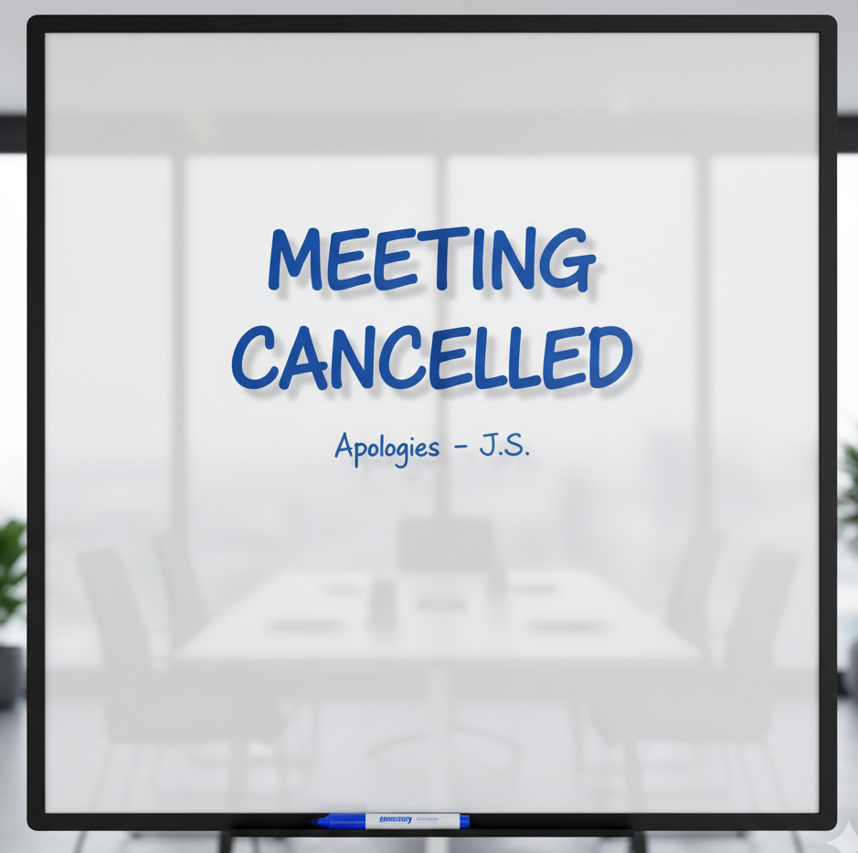
What is 'Text Purpose'?
ANSWER: To inform

Slide 18
Text Purpose (Why it matters)
Knowing the purpose helps you:
Understand the text more easily
Know how to read it (quickly or carefully)
Spot important information
Answer exam questions correctly
In everyday life and at work, you meet many texts. Understanding why they were written helps you use them properly.

Slide 19
Common Purposes (with simple examples)
Purpose | Meaning | Everyday examples
To inform | To give facts or information | News article, train timetable, recipe
To instruct | To tell someone how to do something | Instruction leaflet, recipe steps, how-to guide
To persuade | To make someone do or believe something | Advert, sales email, job application letter
To entertain | To amuse or interest the reader | Short story, joke, magazine article
To describe | To paint a picture with words | Holiday review, product description

Slide 20
Quick Test: Read this short text
1. Special Offer – Fresh Bakery
This week only! Buy any two loaves of bread and get a free pack of butter. Offer ends Sunday 10th August. Visit us at 12 High Street.
What is the main purpose of this text?

Slide 21
Quick Test: Read this short text
1. Special Offer – Fresh Bakery
This week only! Buy any two loaves of bread and get a free pack of butter. Offer ends Sunday 10th August. Visit us at 12 High Street.
What is the main purpose of this text?
ANSWER: To persuade

Slide 22
Quick Test: Read this short text
2. Bus Timetable Change
From Monday 11 August, the number 12 bus will leave the station at 8.15 am instead of 8.00 am. The evening bus will still leave at 5.30 pm. Sorry for any inconvenience.
What is the main purpose of this text?

Slide 23
Quick Test: Read this short text
2. Bus Timetable Change
From Monday 11 August, the number 12 bus will leave the station at 8.15 am instead of 8.00 am. The evening bus will still leave at 5.30 pm. Sorry for any inconvenience.
What is the main purpose of this text?
ANSWER: To inform

Slide 24
Quick Test: Read this short text
How to Reset Your Password
Go to the login page.
Click “Forgotten password”.
Enter your email address.
Check your email for the reset link.
Click the link and type a new password.
What is the main purpose of this text?

Slide 25
Quick Test: Read this short text
How to Reset Your Password
Go to the login page.
Click “Forgotten password”.
Enter your email address.
Check your email for the reset link.
Click the link and type a new password.
What is the main purpose of this text?
ANSWER: To instruct

Slide 26
GAME TIME
TEXT PURPOSE | Baamboozle - Baamboozle | The Most Fun Classroom Games!
https://www.baamboozle.com/game/3710550

Slide 27
TEXT PURPOSE
WORKSHEET
(Word Document)

Slide 28
Homework
Find three different texts at home or online (for example: a leaflet, an advert, a short email, a recipe, a news headline).
For each one, write:
  What the text is
  Its main purpose
  One reason why you think that is the purpose
Share your answers with the class in the next lesson.

