Slide 1
Functional Skills English Level 1
Letter Writing
How to write a clear, formal and well-structured letter

Slide 2
Session Aims
By the end of this lesson, you will be able to:
• understand the purpose of formal letter writing
• identify the main features of a formal letter
• understand the Pearson letter template
• organise ideas into clear paragraphs
• give views, reasons and suggestions clearly
• write a formal letter and check your SPaG

Slide 3
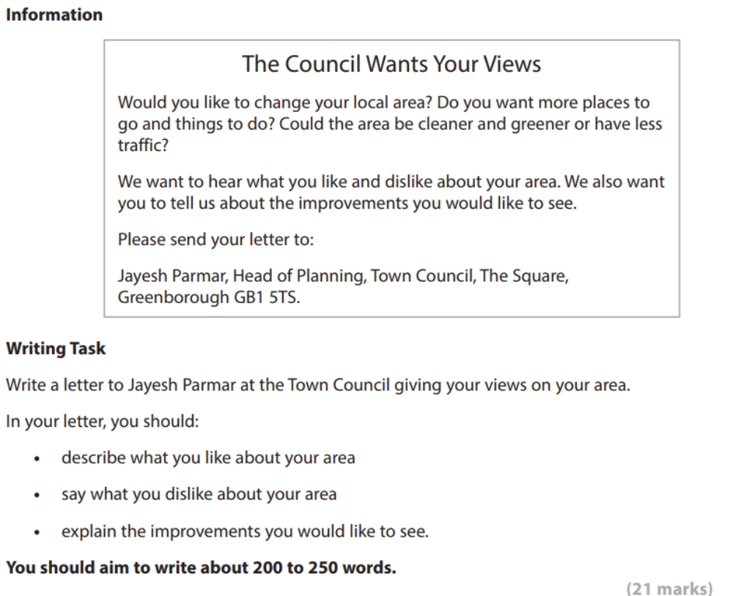
Pearson Letter Writing Task

Slide 4
What Is a Formal Letter?
Definition: A formal letter is a letter written to someone in a professional or official situation.
You may write a formal letter to a council, company, manager, school, college or organisation.
A good formal letter should:
• use a polite and respectful tone
• explain clearly why you are writing
• organise information into paragraphs
• include facts, views, reasons and suggestions
• end with an appropriate closing

Slide 5
Purpose and Audience
Purpose
• to give your views clearly
• to explain what you like and dislike
• to suggest improvements
• to persuade the reader to take your ideas seriously
Audience
• For this task, the letter is to the Head of Planning at the Town Council.
• The language should be formal, polite and clear.

Slide 6
Pearson Letter Template
The Pearson writing frame is divided into these parts:
• Your address
• Their address
• Date
• Polite opening greeting / salutation
• Introductory paragraph: why you are writing
• Describe what you like and dislike about the area
• Explain the improvements you would like to see
• Concluding paragraph and closing salutation

Slide 7
Explaining the Layout
Addresses and date: show who the letter is from, who it is to, and when it was written.
Greeting: use Dear Mr Parmar, or Dear Sir/Madam if you do not know the name.
Introduction: say why you are writing.
Main paragraphs: explain what you like, what you dislike and what improvements you want.
Conclusion: finish politely and summarise what you hope will happen.
Closing: use Yours sincerely if you know the name, or Yours faithfully if you do not.

Slide 8
Useful Formal Letter Language
Useful phrases:
• I am writing to give my views about...
• One thing I like about the area is...
• However, I am concerned about...
• In my opinion...
• I would like to suggest that...
• This would improve the area because...
• I hope you will consider these suggestions.
Keep the tone polite, even when you are explaining problems.

Slide 9
Model Formal Letter
24 Park Road
Greenborough
GB1 4ST
Jayesh Parmar
Head of Planning
Town Council
The Square
Greenborough
GB1 5TS
18 August 2026
Dear Mr Parmar,
I am writing to give my views about my local area and to suggest some improvements that would make it better for residents.
One thing I like about Greenborough is that it has friendly people and useful local shops. There is also a small park near my home, which is important because families can spend time outside and children have a place to play. The bus service is quite reliable, so it is easy for people to travel to work, college and nearby towns.
However, there are also some problems. The streets are not always clean, and litter is often left near the shops and bus stops. In the evenings, some roads feel unsafe because the street lights are too dim. There is also too much traffic near the school, especially in the morning. There are not enough activities for young people, so many teenagers spend time outside shops after school.
I would like the council to provide more bins, improve the street lighting and add a safe crossing near the school. These changes would make the area cleaner, safer and more pleasant for everyone. I would also like to see more benches and more community events during the school holidays.
I hope you will consider these suggestions carefully. I look forward to hearing from you.
Yours sincerely,
Aisha Khan
Word count: 216 words.

Slide 10
Check Your SPaG and Structure
Before you finish, check:
• Have I included addresses, date, greeting and closing?
• Have I explained why I am writing?
• Have I described what I like about the area?
• Have I described what I dislike about the area?
• Have I explained the improvements I would like to see?
• Have I used paragraphs?
• Have I checked spelling, punctuation and grammar?
• Have I written about 200 to 250 words?

Slide 11
Class Practice – Letter Writing
Your local library wants residents’ views about how it can improve its services.
Write a formal letter to the Library Manager giving your views.
In your letter, you should:
• describe what you like about the library
• say what you dislike or find difficult
• explain the improvements you would like to see
• give reasons for your suggestions
• use a polite opening and closing
Aim to write 200 to 250 words.

Slide 12
Homework – Letter Writing
Your college is asking learners for ideas to improve the canteen.
Write a formal letter to the College Manager giving your views.
In your letter, you should:
• describe what you like about the canteen
• say what you dislike about it
• explain what improvements you would like to see
• give reasons why these changes would help learners
• finish with a polite conclusion
Aim to write 200 to 250 words.

